Slide 1

AI ASSISTED ACCESSIBILITY FOR VISUALLY IMPAIRED PEOPLE
GUIDE NAME : Mr.R.ROSHAN JOSHUA.,M.E.,AP/AI
TEAM MEMBERS:
THEJEAL SRI K (811721243057)
SUJAINITHA G (811721243055)
DHIVYA A . D (811721243014)
SATHVIKA A (811721243049)
1

Slide 2
OBJECTIVE
To create an advanced image captioning system that generates precise descriptions for images, with a seamless conversion to audio, promoting inclusivity by enabling visually impaired individuals to access and comprehend visual content effectively.
2

Slide 3
PROBLEM DEFINITION
Existing System:
Utilizes deep learning techniques for image captioning from input images using CNNs for feature extraction and RNNs for text generation. Incorporates attention mechanisms for improved captioning accuracy.
Proposed System:
Develops an app integrating deep learning for image captioning, employing CNNs, RNNs,and LSTM and adds text-to-audio conversion for inclusivity. Implements real time image capturing and audio conversion for instant accessibility.
3

Slide 4
LITERATURE SURVEY
S.NO | PAPER TITLE | AUTHOR NAME | YEAR PUBLISHED | TECHNIQUE USED | DEMERITS
1. | Automatic Image and Video Caption Generation With Deep Learning: A Concise Review and Algorithmic Overlap | Soheyla amirian, khaled rasheed,thiab r. Taha, and hamid r. Arabnia | 2020 | Convolutional neural network(cnn), recurrent neural network(rnn) | May struggle with complex scenes or videos with fast-changing content, leading to inaccuracies in captions.
2. | A Study of ConvNeXt Architectures for Enhanced Image Captioning | Leo ramos , edmundo casas , cristian romero , francklin rivas- echeverría and manuel eugenio morocho- cayamcela | 2024 | Integrated ConvNeXt with LSTM | Potential challenges like model complexity or resource demands were not explicitly discussed.
4

Slide 5
S.NO | PAPER TITLE | AUTHOR NAME | YEAR PUBLISHED | TECHNIQUE USED | DEMERITS
3. | Summarization of Text and Image Captioning in Information Retrieval Using Deep Learning Techniques | P. Mahalakshmi and n. Sabiyath fatima | 2022 | Employed BiLSTM and DBN | Possible complexity or data dependency challenges were not explicitly addressed.
4. | Image Captioning Model Using Part-of- Speech Guidance Module for Description With Diverse Vocabulary | Ju-won bae , soo- hwan lee, won-yeol kim , ju-hyeon seong , and dong- hoan seo | 2022 | Implemented POS guidance module and multimodal- based model | Potential limitations such as increased complexity or computational overhead were not explicitly discussed.
5

Slide 6
S.NO | PAPER TITLE | AUTHOR NAME | YEAR PUBLISHED | TECHNIQUE USED | DEMERITS
5. | Switching Text-Based Image Encoders for Captioning Images With Text | Arisa ueda , wei yang , and komei sugiura | 2023 | Leveraged CLIP models and multimodal transformer | Potential complexity or computational demands not explicitly addressed.
6. | Voice Conversion Based on Deep Neural Networks for Time- Variant Linear Transformations | Gaku kotani , daisuke saito and nobuaki minematsu | 2022 | Top-down knowledge and restricted time- variant linear transformation and homo- domain mapping | Potential scope restrictions or model complexity were not explicitly addressed.
6

Slide 7
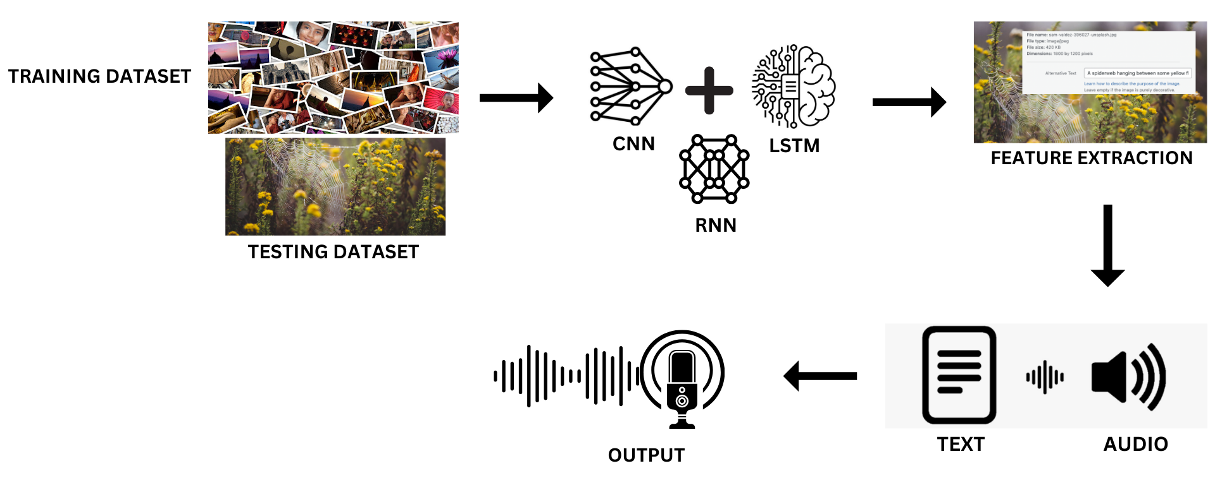
ARCHITECTURE DIAGRAM
7

Slide 8
SYSTEM SPECIFICATION
HARDWARE SPECIFICATION :
Computer - minimum of 4GB RAM & dual-core processor.
MOBcam - at least 720p & high frame rate of at least 30fps.
Stable internet connection.
Storage.
SOFTWARE SPECIFICATION :
Python programming language - Python 3.x installed on the computer .
Operating system – Windows.
Python libraries such as – NumPy , pandas, tensor flow, SciPy, pillow.
HTML/CSS or JavaScript - for UI design.
8

Slide 9
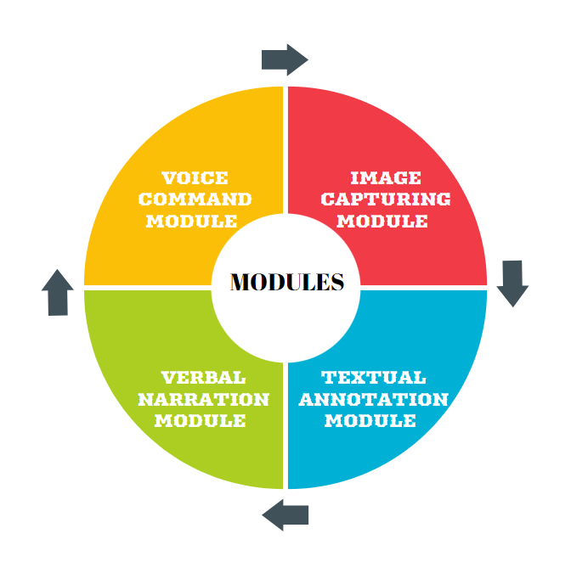
MODULES
9

Slide 10
VOICE COMMAND MODULE
The Voice Command Module utilizes speech recognition for user commands, enhancing accessibility and user experience through seamless interaction.
Voice Command Processing: Recognizes user commands, executes actions, and
provides feedback.
Screenshot Automation: Automatically captures screen, integrates voice commands, and
provides feedback.
Accessibility and Optimization: Enhances accessibility, promotes inclusivity, and optimizes performance for efficiency.
10

Slide 11
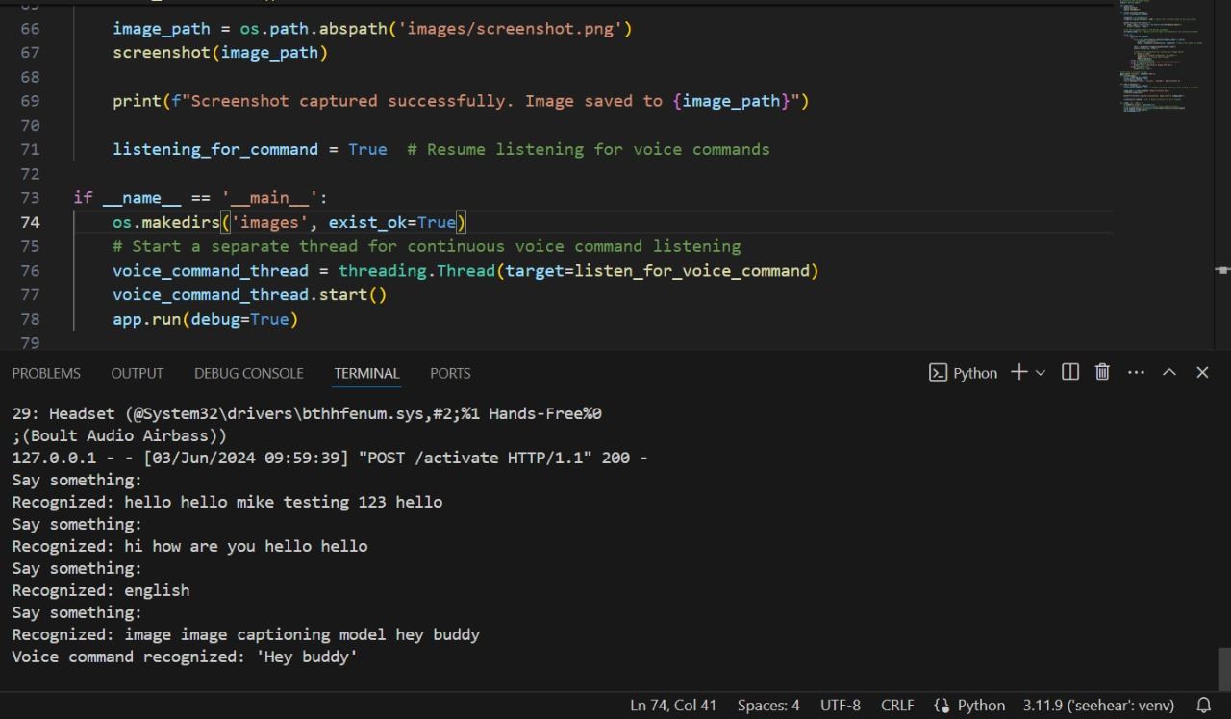

Slide 12
IMAGE CAPTURING MODULE
The image capturing module uses a CNN to extract features from images and an LSTM-based model to generate descriptive captions. Attention mechanisms and context details enhance the accuracy and richness of these captions.
Feature Extraction:
Input images are processed through a Convolutional Neural Network (CNN) to extract high-level features.
Caption Generation:
Extracted features are fed into an LSTM-based model to generate descriptive captions.
Enhancing with Attention:
Attention mechanisms focus on specific image parts during caption generation.
11

Slide 13
TEXTUAL ANNOTATION MODULE
The textual annotation process for images involves several sophisticated steps to generate descriptive captions, leveraging both Convolutional Neural Networks (CNNs) and Recurrent Neural Networks (RNNs) with attention mechanisms to improve accuracy.
Feature Extraction with CNN:
An input image is passed through layers of a CNN.
The CNN processes the image through multiple convolutional and pooling layers.
High-level feature representations are extracted and used in the next stage.
12

Slide 14
Captioning with LSTM:
The extracted features are provided to an LSTM-based captioning model.
The LSTM processes these features sequentially to generate a sentence that describes the image.
The generated sentence is the output caption, aiming to be both accurate and descriptive.
Enhancing with Attention and Context:
Attention mechanisms focus on different image parts during caption generation.
This dynamic focusing highlights important image aspects, improving caption quality.
Contextual details about objects, actions, and the scene enrich the captions, making them more informative and accurate.
13

Slide 15
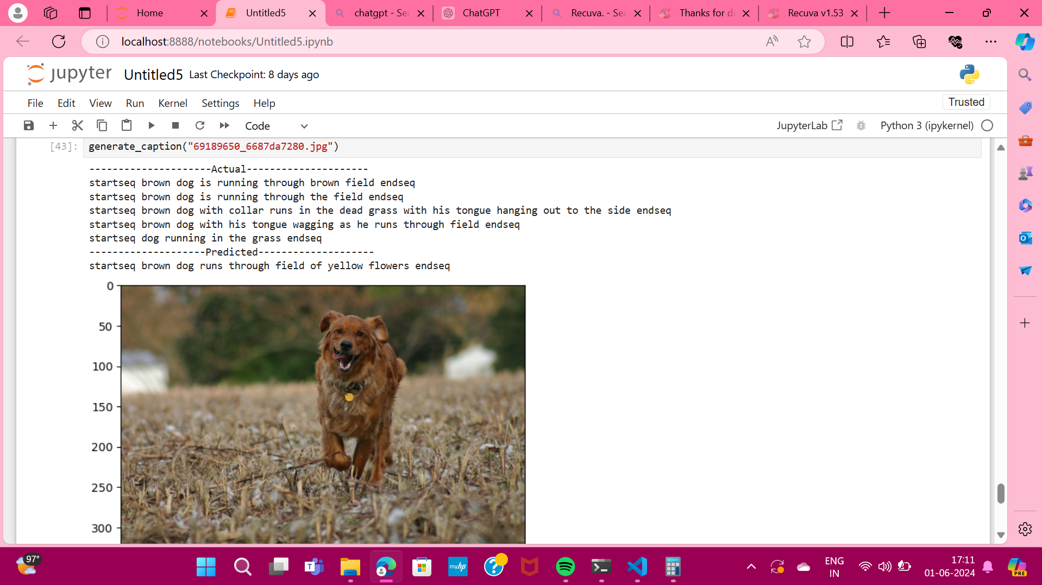

Slide 16
VERBAL NARRATION MODULE
The verbal narration module is designed to enhance accessibility for visually impaired users by converting generated captions into natural-sounding audio. This process utilizes a text-to-speech (TTS) engine.
Generate Audio:
The module receives a caption and triggers the TTS engine to convert the text into audio.
The TTS engine synthesizes the text into natural-sounding speech.
Users can customize voice characteristics such as pitch and speed to match their preferences, ensuring a more personalized listening experience.
14

Slide 17
Optimization for Speed and Quality:
Efficient algorithms for quick audio generation.
Resource caching speeds up conversion process.
Optimizations ensure fast, high-quality audio synthesis.
Provides seamless user experience.
Voice Command:
Voice command support enables hands-free audio playback control.
Enhances accessibility by allowing users to navigate audio content with their voice.
Makes the system more intuitive and user-friendly.
15

Slide 18
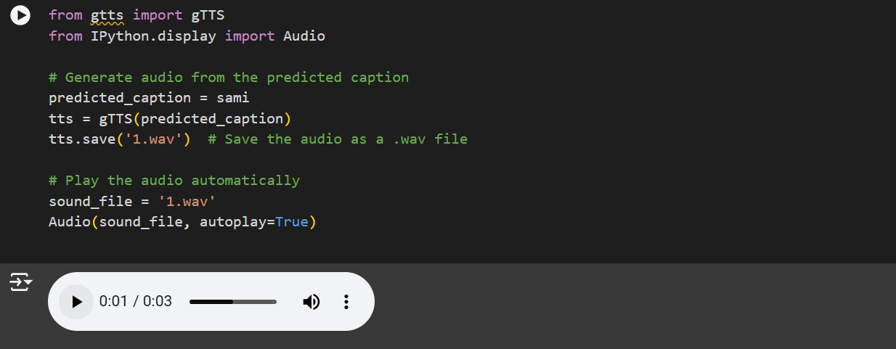

Slide 19
ADVANTAGES
Assists visually impaired in various tasks.
Empowers independence, reducing assistance dependence.
Navigation aid with audio-based directions.
Real-time object detection for safety.
Virtual assistant for reminders, scheduling, info
16

Slide 20
APPLICATIONS
Utilizes AI to identify objects through smartphone cameras.
Enables users to understand their surroundings independently.
Allows hands-free interaction and control of the device.
Identifies and describes colors in the environment or on objects.
Adaptable user interfaces with high contrast, large fonts, and tactile feedback.
Allows users to navigate through gestures or touch-based interactions.
17

Slide 21
CONCLUSION
Deep learning advances bolster image description accuracy, aiding visually impaired users. Seamless caption-to-audio conversion enhances digital inclusivity. These innovations elevate system accuracy, promoting accessibility for visually impaired individuals
18

Slide 22
REFERENCES
J Sudhakar,Viswesh V Iyer , Sree T Sharmila (2022) Image caption generation using deep neural
networks. vol. 175, pp. 674–685.
Zainab Umair Kmangar and Ghulam Mutjaba Shaikh (2023) Image Caption Generation Related to Object Detection and Colour Recognition Using Transformer-Decoder. vol.9, pp. 449–461.
Minsi Wang, Li Song, Xiaokang Yang (2020) Aparallel-fusion RNN-LSTM architecture for image caption generation. vol. 17, no. 1, pp. 17–29.
Rajwinder Kaur and Gurpreet Singh (2023) Automatic Image Captioning for Medical Diagnosis Report Generation.vol. 6, pp. 41034–41041.
19

Slide 23
THANK YOU
20

